Slide 1
Microsoft Teams User Group Berlin
12. August 2021

Slide 2
Danke!

Slide 3
Agenda
18:00 - 18:15 | Landing Zone
18:15 - | Talk 1 – Zugriff auf Teams Inhalte über Microsoft Graph Martin Gudel (@AtholyMardies)
 | Pause
 | Microsoft Teams Neuigkeiten Thomas Stensitzki
20:45 - ? | Fragen und Antworten rund um Teams Organisatorisches
Dieses Meeting wird aufgezeichnet. This meeting will be recorded.

Slide 4
Zugriff auf Teams Inhalte über Microsoft Graph
Fällt heute leider aus
Martin Gudel @AtholyMardies

Slide 5
Pause ☺
→ Um 19:30 Uhr geht es weiter

Slide 6
Neues in Microsoft Teams Ankündigungen & Rollouts
Updates
Thomas Stensitzki

Slide 7
Neuigkeiten in Microsoft Teams
Fluid Live Components in Teams Chat (→ August)
Swap Content and Gallery is coming back (→ August)
New assignment experience in modal window for Breakout Rooms (→ August)
Music Mode for Teams (→ September)
End-to-end encryption for Teams calling (→ September)
New Side-by-Side and Reporter Presenter Modes with Desktop and Window Sharing (→ September)

Slide 8
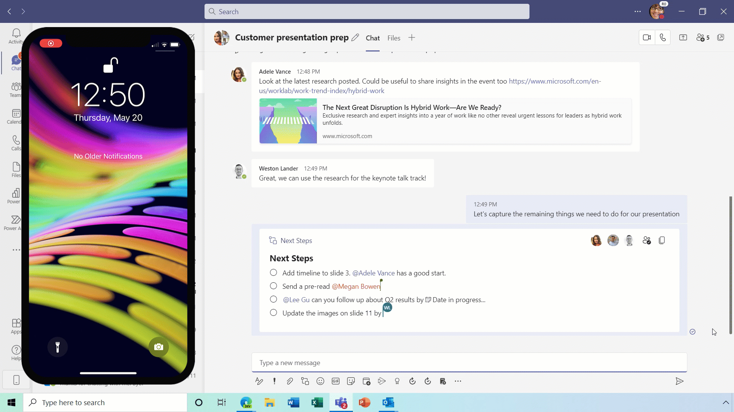
Fluid Live Components in Teams Chat
Weitere Informationen

Slide 9
Neuigkeiten in Microsoft Teams
Fluid Live Components in Teams Chat (→ August)
Swap Content and Gallery is coming back (→ August)
New assignment experience in modal window for Breakout Rooms (→ August)
Music Mode for Teams (→ September)
End-to-end encryption for Teams calling (→ September)
New Side-by-Side and Reporter Presenter Modes with Desktop and Window Sharing (→ September)

Slide 10
Neuigkeiten in Microsoft Teams
Fluid Live Components in Teams Chat (→ August)
Swap Content and Gallery is coming back (→ August)
New assignment experience in modal window for Breakout Rooms (→ August)
Music Mode for Teams (→ September)
End-to-end encryption for Teams calling (→ September)
New Side-by-Side and Reporter Presenter Modes with Desktop and Window Sharing (→ September)

Slide 11
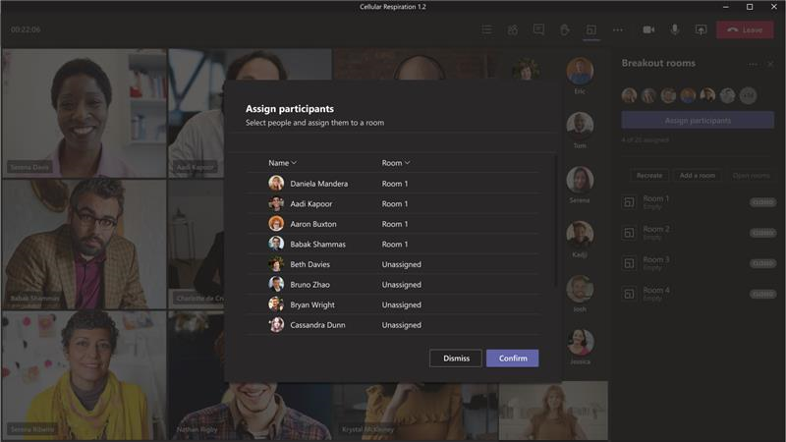
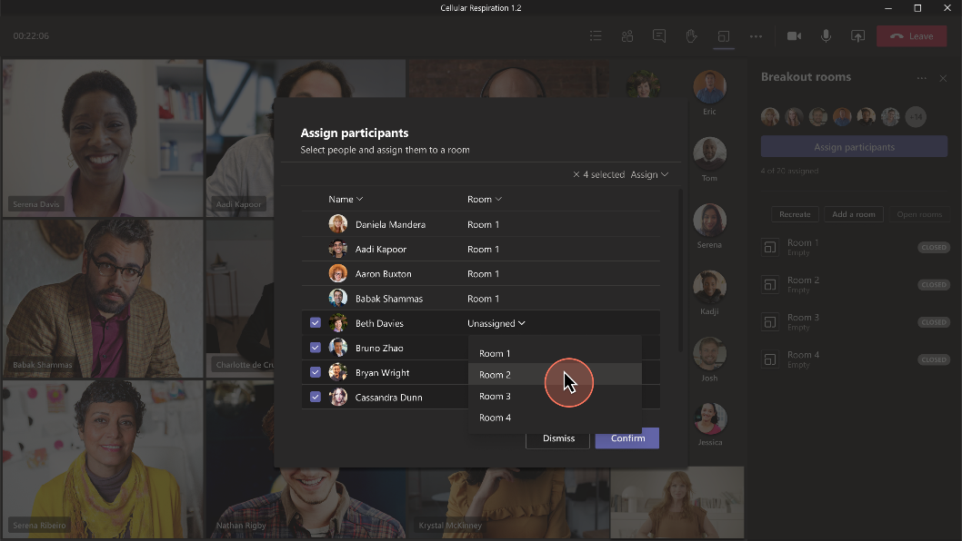
New assignment experience in modal window for Breakout Rooms
Notes:
The organizer will have the ability to assign participants when rooms are closed and/or re-assign them while rooms are open via this new modal window.

Slide 12
Neuigkeiten in Microsoft Teams
Fluid Live Components in Teams Chat (→ August)
Swap Content and Gallery is coming back (→ August)
New assignment experience in modal window for Breakout Rooms (→ August)
Music Mode for Teams (→ September)
End-to-end encryption for Teams calling (→ September)
New Side-by-Side and Reporter Presenter Modes with Desktop and Window Sharing (→ September)

Slide 13
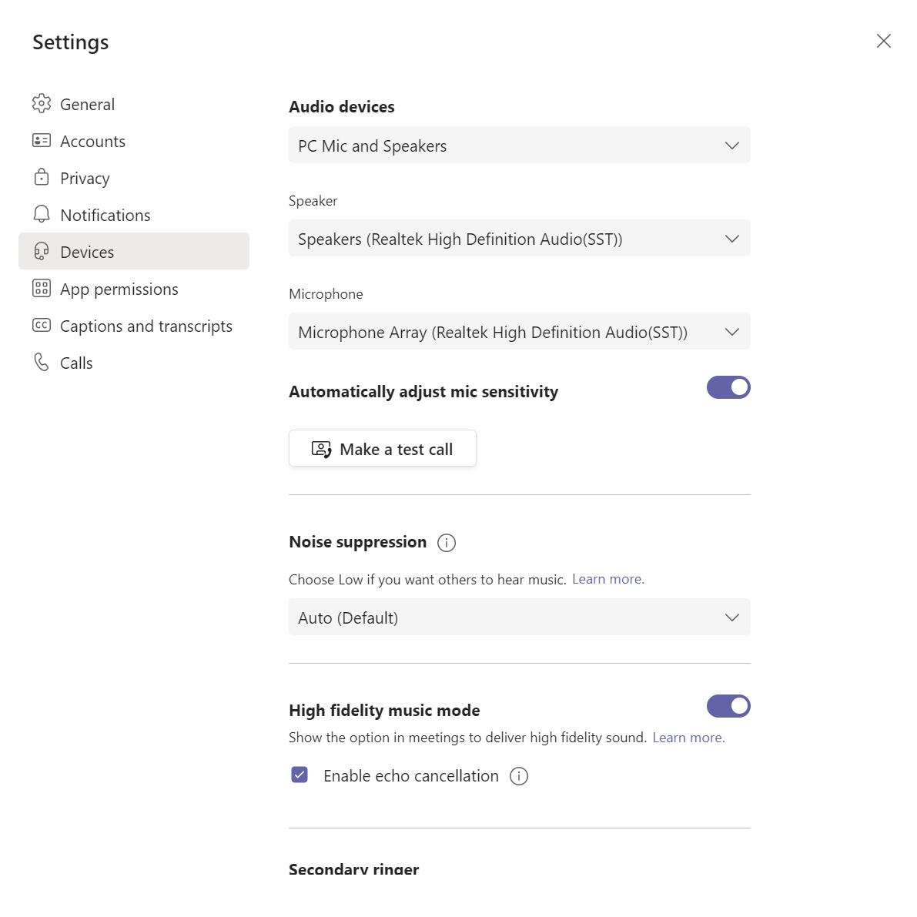
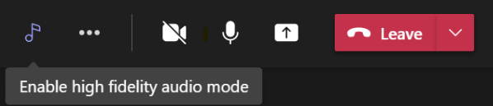
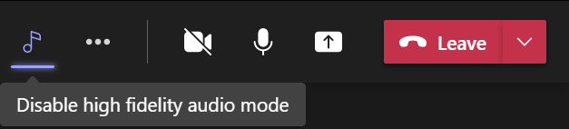
Music Mode for Teams

Slide 14
Neuigkeiten in Microsoft Teams
Fluid Live Components in Teams Chat (→ August)
Swap Content and Gallery is coming back (→ August)
New assignment experience in modal window for Breakout Rooms (→ August)
Music Mode for Teams (→ September)
End-to-end encryption for Teams calling (→ September)
New Side-by-Side and Reporter Presenter Modes with Desktop and Window Sharing (→ September)

Slide 15
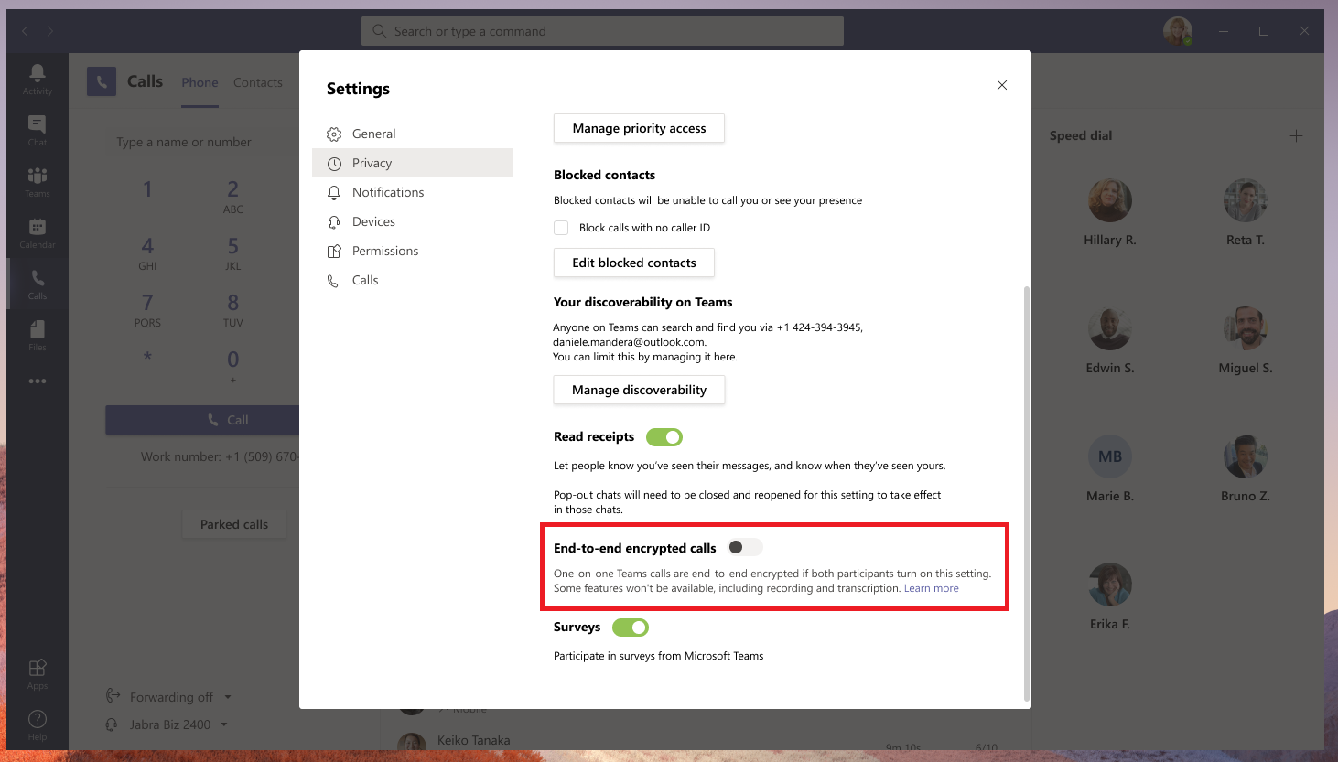
End-to-end encryption for Teams calling
Weitere Informationen

Slide 16
Neuigkeiten in Microsoft Teams
Fluid Live Components in Teams Chat (→ August)
Swap Content and Gallery is coming back (→ August)
New assignment experience in modal window for Breakout Rooms (→ August)
Music Mode for Teams (→ September)
End-to-end encryption for Teams calling (→ September)
New Side-by-Side and Reporter Presenter Modes with Desktop and Window Sharing (→ September)

Slide 17

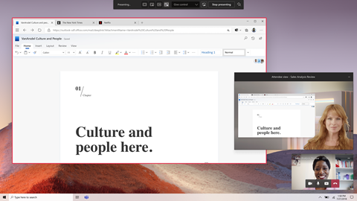

New Side-by-Side and Reporter Presenter Modes with Desktop and Window Sharing
Notes:
Side-By-Side
Reporter Mode

Slide 18
Was ist neu in Teams – für Administratoren
Meeting Join – Custom Branding (→ August/September)
Microsoft 365 Information Governance – Retention Policies for private Channel Messages (→ August) Weitere Informationen
Admins can install Apps in Meetings (→ Juli) Weitere Informationen
Organization-wide Backgrounds (→ Juli)
Together Mode Extensibility (→ August) Weitere Informationen
Teams Meeting Recordings Auto-Expiration in OneDrive and SharePoint (→ November) Weitere Informationen
Manage the Health of Microsoft Teams Rooms Device (→ September)

Slide 19
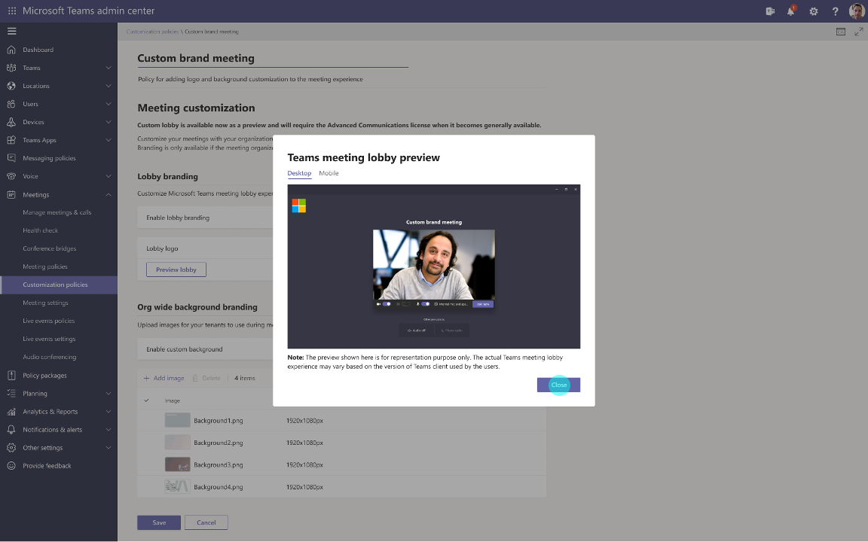
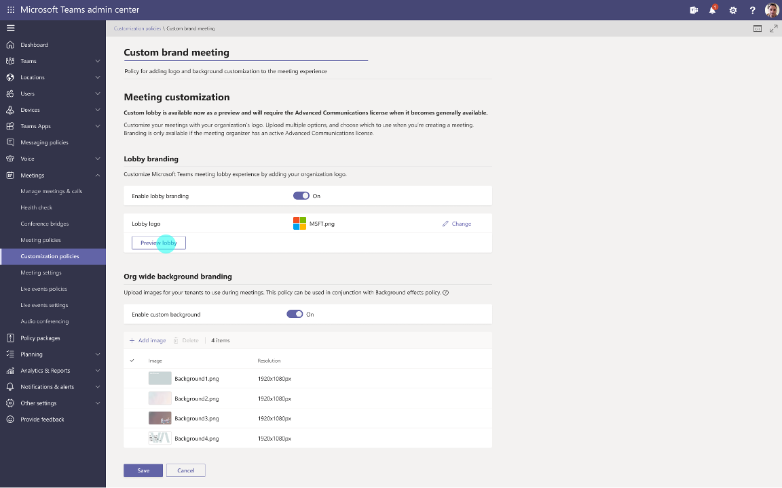
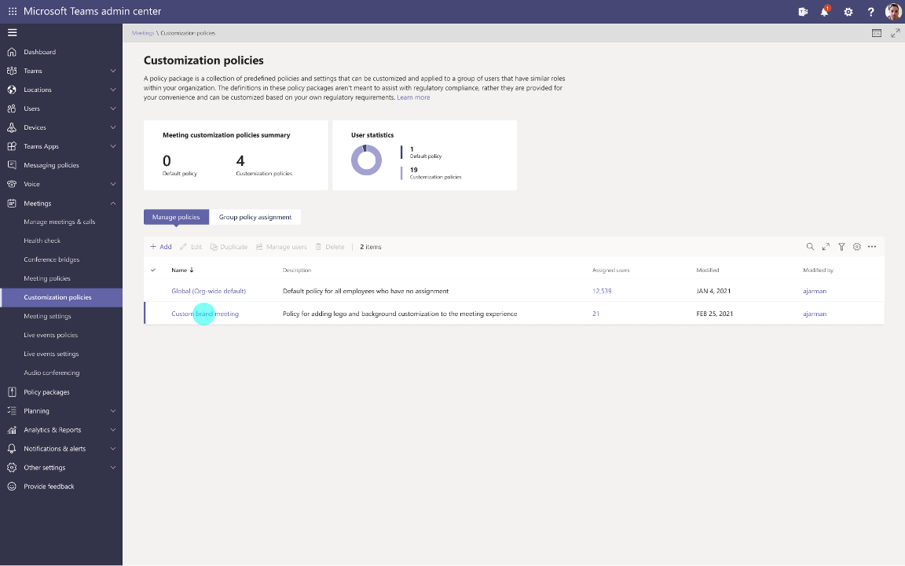
Meeting Join – Custom Branding
Preview! Advanced Communications Lizenz
Ab 1. Januar 2022
Notes:
Updated August 03, 2021: This feature will be available as a preview until December 31, 2021. After that, an Advanced Communications license is required to continue using this feature.

Slide 20
Was ist neu in Teams – für Administratoren
Meeting Join – Custom Branding (→ August/September)
Microsoft 365 Information Governance – Retention Policies for private Channel Messages (→ August) Weitere Informationen
Admins can install Apps in Meetings (→ Juli) Weitere Informationen
Organization-wide Backgrounds (→ Juli)
Together Mode Extensibility (→ August) Weitere Informationen
Teams Meeting Recordings Auto-Expiration in OneDrive and SharePoint (→ November) Weitere Informationen
Manage the Health of Microsoft Teams Rooms Device (→ September)

Slide 21
Was ist neu in Teams – für Administratoren
Meeting Join – Custom Branding (→ August/September)
Microsoft 365 Information Governance – Retention Policies for private Channel Messages (→ August) Weitere Informationen
Admins can install Apps in Meetings (→ Juli) Weitere Informationen
Organization-wide Backgrounds (→ Juli)
Together Mode Extensibility (→ August) Weitere Informationen
Teams Meeting Recordings Auto-Expiration in OneDrive and SharePoint (→ November) Weitere Informationen
Manage the Health of Microsoft Teams Rooms Device (→ September)

Slide 22
Was ist neu in Teams – für Administratoren
Meeting Join – Custom Branding (→ August/September)
Microsoft 365 Information Governance – Retention Policies for private Channel Messages (→ August) Weitere Informationen
Admins can install Apps in Meetings (→ Juli) Weitere Informationen
Organization-wide Backgrounds (→ Juli)
Together Mode Extensibility (→ August) Weitere Informationen
Teams Meeting Recordings Auto-Expiration in OneDrive and SharePoint (→ November) Weitere Informationen
Manage the Health of Microsoft Teams Rooms Device (→ September)

Slide 23
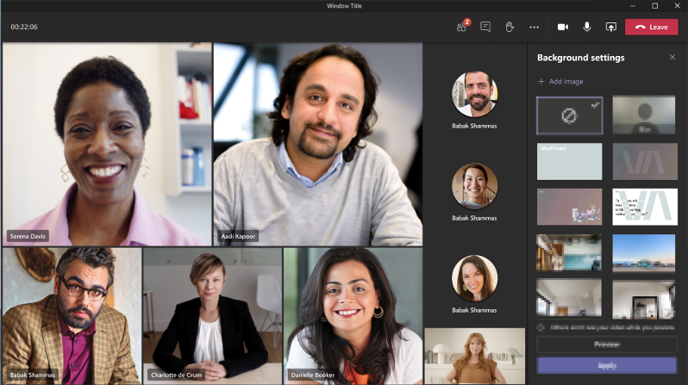
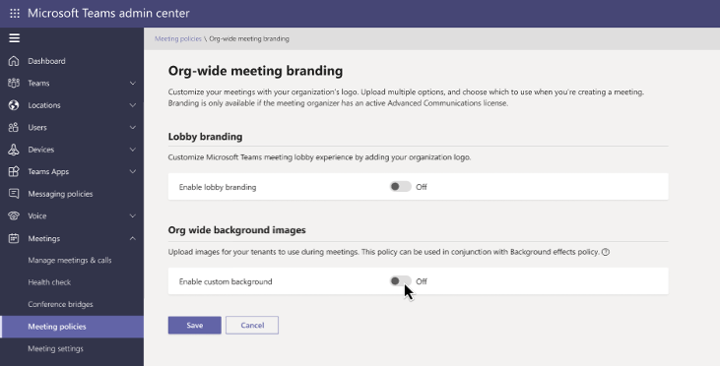
Organization-wide Backgrounds
Preview! Advanced Communications Lizenz
Ab 1. Januar 2022
Notes:
This feature will be available as a preview until December 31, 2021. After that, an Advanced Communications license is required to continue using this feature.
Images can be either PNG or JPG format; they should be no smaller than 360x360px and no larger than 2048x2048px. You can host up to 50 images in your tenant.

Slide 24
Was ist neu in Teams – für Administratoren
Meeting Join – Custom Branding (→ August/September)
Microsoft 365 Information Governance – Retention Policies for private Channel Messages (→ August) Weitere Informationen
Admins can install Apps in Meetings (→ Juli) Weitere Informationen
Organization-wide Backgrounds (→ Juli)
Together Mode Extensibility (→ August) Weitere Informationen
Teams Meeting Recordings Auto-Expiration in OneDrive and SharePoint (→ November) Weitere Informationen
Manage the Health of Microsoft Teams Rooms Device (→ September)

Slide 25
Was ist neu in Teams – für Administratoren
Meeting Join – Custom Branding (→ August/September)
Microsoft 365 Information Governance – Retention Policies for private Channel Messages (→ August) Weitere Informationen
Admins can install Apps in Meetings (→ Juli) Weitere Informationen
Organization-wide Backgrounds (→ Juli)
Together Mode Extensibility (→ August) Weitere Informationen
Teams Meeting Recordings Auto-Expiration in OneDrive and SharePoint (→ November) Weitere Informationen
Manage the Health of Microsoft Teams Rooms Device (→ September)

Slide 26
Was ist neu in Teams – für Administratoren
Meeting Join – Custom Branding (→ August/September)
Microsoft 365 Information Governance – Retention Policies for private Channel Messages (→ August) Weitere Informationen
Admins can install Apps in Meetings (→ Juli) Weitere Informationen
Organization-wide Backgrounds (→ Juli)
Together Mode Extensibility (→ August) Weitere Informationen
Teams Meeting Recordings Auto-Expiration in OneDrive and SharePoint (→ November) Weitere Informationen
Manage the Health of Microsoft Teams Rooms Device (→ September)

Slide 27
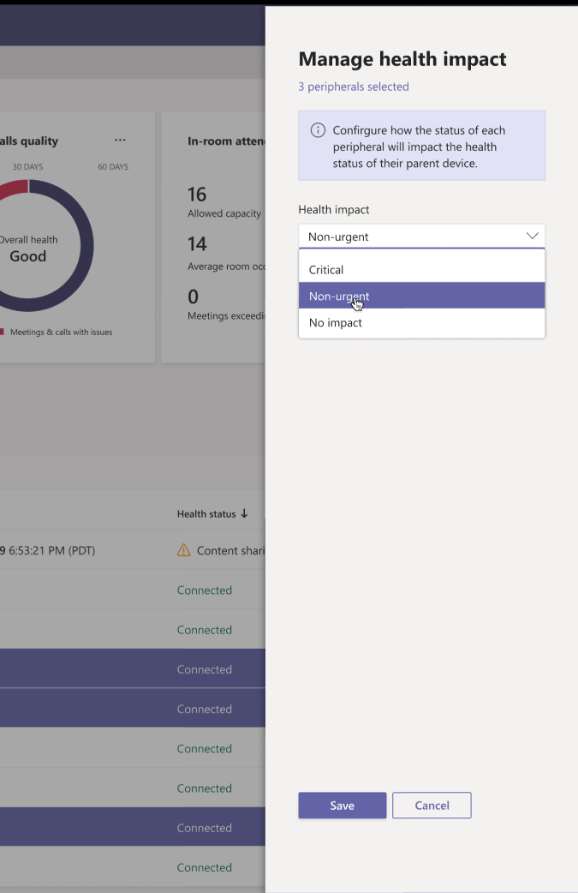
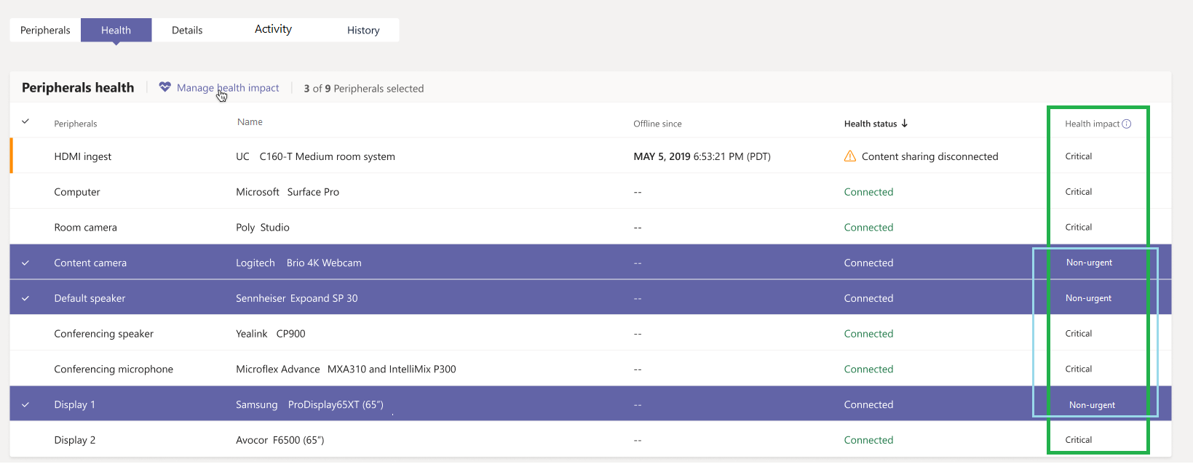
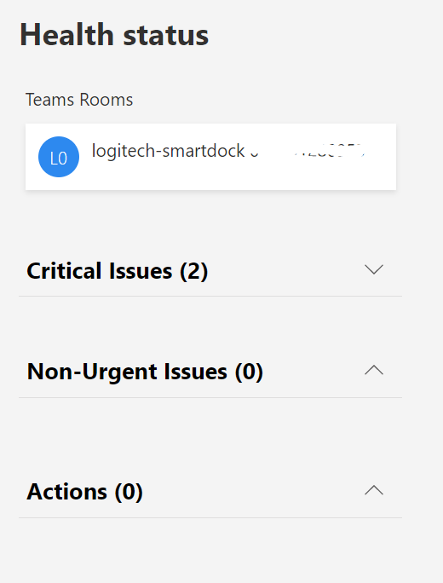
Manage the Health of Microsoft Teams Rooms Device

Slide 28
Was ist neu in Teams – für Administratoren
Enforcement of Licenses on Teams Phones (→ Teams App Update) Weitere Informationen
Teams Follows Office Preview (→ August)

Slide 29
Was ist neu in Teams – für Administratoren
Enforcement of Licenses on Teams Phones (→ Teams App Update) Weitere Informationen
Teams Follows Office Preview (→ August)

Slide 30
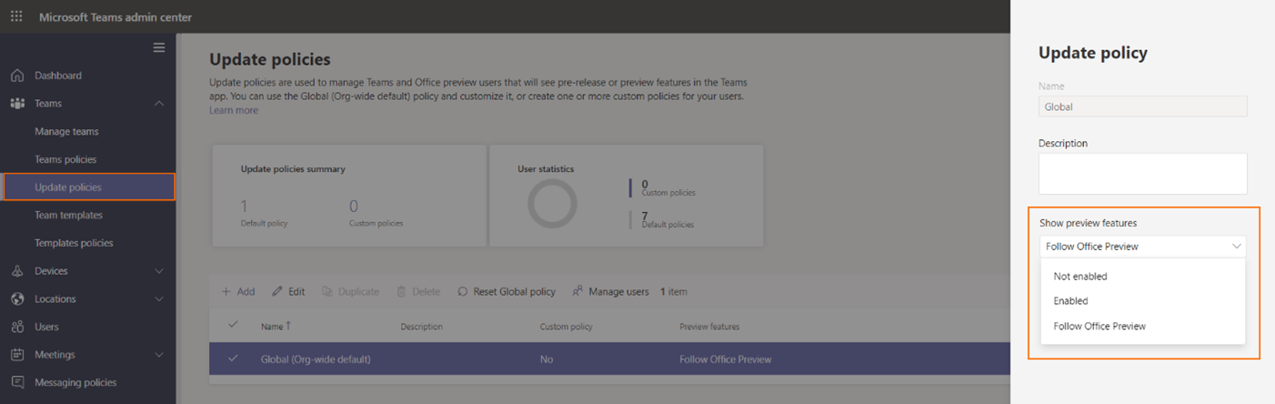
Teams Follows Office Preview
Notes:
Set-CsTeamsUpdateManagementPolicy -Identity Global -AllowPublicPreview "FollowOfficePreview“
This policy will not impact existing Office preview settings. Tenants with users who are currently in Teams Technology Adoption Program (TAP) will remain in TAP and this policy will not have any impact on those user's preview settings. Additionally, this policy will not have an impact on Targeted Releases.

Slide 31
Was ist neu in Teams – Der Blog
What‘s New in Microsoft Teams | July 2021
What‘s New in Microsoft Teams | June 2021
What’s New in Microsoft Teams | May 2021
Microsoft Teams Blog

Slide 32
Thema 2
Speaker @Speaker

Slide 33
Organisatorisches

Slide 34
Organisatorisches
Microsoft Community Tenant für User Groups
Microsoft 365 Gast-Konten für User Group Mitglieder
Anmeldung: https://go.granikos.eu/TeamsUGForm
Einheitlicher Teams Meeting Teilnahme-Link
https://teamsusergroup.berlin/meetup

Slide 35
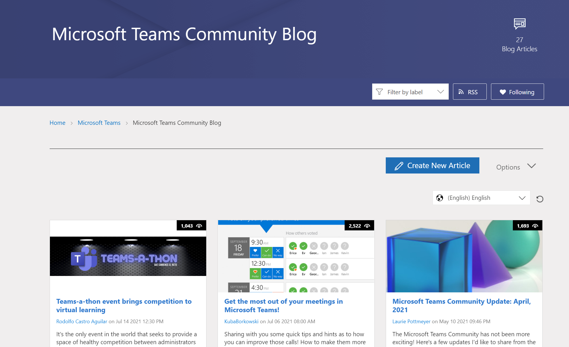
Teams Community Blog
→https://aka.ms/TeamsCommunityBlogger

Slide 36
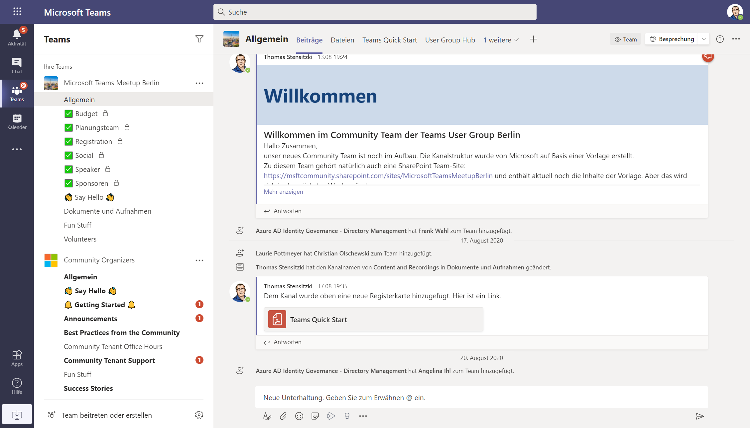

Slide 37
Vielen Dank für eure Teilnahme!
Das nächste Meetup:
→ 21. Oktober 2021
https://TeamsUserGroup.Berlin
Spread the Word!
#TeamsUGBerlin
Aufzeichnungen unserer Meetups sind im Community Team verfügbar.

Slide 38
Offene Diskussion

